Slide 1
Singletons for sharing data and functionality
Each web application you build is composed of objects that collaborate to get stuff done. These objects need to be instantiated and wired together for the app to work. In Angular apps most of these objects are instantiated and wired together automatically by the injector service.
The injector creates two types of objects, services and specialized objects.
Services are objects whose API is defined by the developer writing the service.
Specialized objects conform to a specific Angular framework API. These objects are one of controllers, directives, filters or animations.
The injector needs to know how to create these objects. You tell it by registering a "recipe" for creating your object with the injector. There are five recipe types.
The most verbose, but also the most comprehensive one is a Provider recipe. The remaining four recipe types — Value, Factory, Service and Constant — are just syntactic sugar on top of a provider recipe.

Slide 2
Angular comes with different types of services. Each one with its own use cases.
Something important that you have to keep in mind is that the services are always singleton, it doesn’t matter which type you use. This is the desired behavior.
NOTE: A singleton is a design pattern that restricts the instantiation of a class to just one object. Every place where we inject our service, will use the same instance.

Slide 3
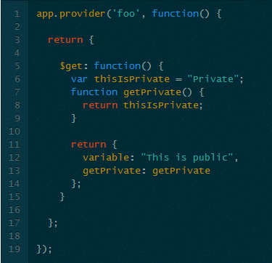
Provider
Provider is the parent of almost all the other services (all but constant) and it is also the most complex but more configurable one.
Let’s see a basic example:

Slide 4
A provider on its simplest form, just needs to return a function called $get which is what we inject on the other components. So if we have a controller and we want to inject this foo provider, what we inject is the $get function of it.
Why should we use a provider when a factory is much simple? Because we can configure a provider in the config function. We can do something like this:

Slide 5
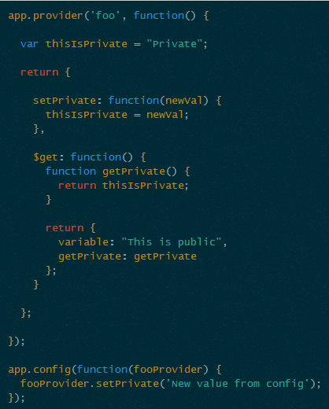
Here we moved the thisIsPrivate outside our $get function and then we created a setPrivatefunction to be able to change thisIsPrivate in a config function. Why do we need to do this? Won’t it be easier to just add the setter in the $get?
This has a different purpose.
Imagine we want to create a generic library to manage our models and make some REST petitions. If we hardcode the endpoints URLs, we are not making it any generic, so the idea is to be able to configure those URLs and to do so, we create a provider and we allow those URLs to be configured on a config function.

Slide 6
Important points for providers:-
Notice that we have to put nameProvider instead of just name in our config function. To consume it, we just need to use name.
Providers have two different places to make injections, on the provider constructor and on the $get function. On the provider constructor we can only inject other providers and constants (is the same limitation as the config function). On the $get function we can inject all but other providers (but we can inject other provider’s $get function).
Remember: To inject a provider you use: name + ‘Provider’ and to inject its $get function you just use name
show example

Slide 7
Factory
Provider are good, they are quite flexible and complex. But what if we only want its $getfunction? I mean, no configuration at all. Well, in that cases we have the factory. Let’s see an example:

Slide 8
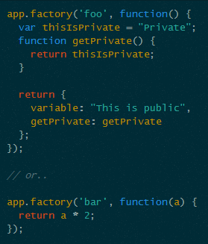
As I said before, all types are singleton, so if we modify foo.variable in one place, the other places will have that change too.
We can inject everything but providers on a factory
and
we can inject it everywhere except on theprovider constructor and config functions.
show example

Slide 9

Value
Factory is good, but what if I just want to store a simple value? I mean, no injections, just a simple value or object. Well angular has you covered with the value service:
Example:
Internally a value is just a factory. And since it is a factory the same injection rules applies, AKA can’t be injected into provider constructor or config functions.
Run example

Slide 10
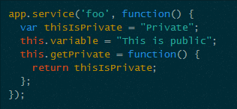
Service
So having the complex provider, the more simple factory and the value services, what is the service service? Let’s see an example first:

Slide 11
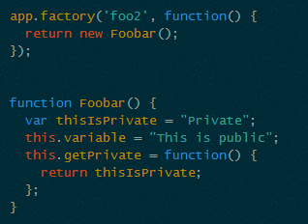
The service service works much the same as the factory one. The difference is simple: The factory receives a function that gets called when we create it and the service receives a constructor function where we do a new on it (actually internally is uses Object.create instead ofnew).
In fact, it is the same thing as doing this:
Foobar is a constructor function and we instantiate it in our factory when angular processes it for the first time and then it returns it. Like the service, Foobar will be instantiated only once and the next time we use the factory it will return the same instance again.

Slide 12

If we already have the class and we want to use it in our service we can do that like the following:
If you’re wondering, what we did on foo2 is actually what angular does with services internally. That means that service is actually a factory and because of that, same injection rules applies.
We can inject everything but providers on a service
and
we can inject it everywhere except on theprovider constructor and config functions.
Show example

Slide 13

Constant
Then, you’re expecting me to say that a constant is another subtype of provider like the others, but this one is not. A constant works much the same as a value as we can see here:-
So… what’s the difference then? A constant can be injected everywhere and that includes provider constructor and config functions. That is why we use constant services to create default configuration for directives, because we can modify those configuration on our config functions.
You are wondering why it is called constant if we can modify it and well that was a design decision.
[its coz of decorators….]

Slide 14
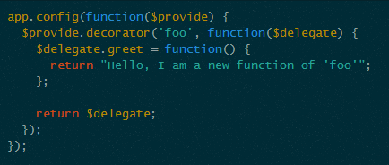
Bonus 1: Decorators
So you decided that the foo service I sent to you lacks a greet function and you want it. Will you modify the factory? No! You can decorate it:
$provide is what Angular uses internally to create all the services. We can use it to create new services if we want but also to decorate existing services. $provide has a method called decorator that allows us to do that. decorator receives the name of the service and a callback function that receives a $delegate parameter. That $delegate parameter is our original service instance.

Slide 15
Here we can do what we want to decorate our service. In our case, we added a greet function to our original service. Then we return the new modified service.
Now when we consume it, it will have the new greet function .
The ability to decorate services comes in handy when we are consuming 3rd party services and we want to decorate it without having to copy it in our project and then doing there the modifications.

Slide 16
Again why Constants are called constants if we can change its content/properties?
value(name, value);
Value services are similar to constant services, except that they cannot be injected into a module configuration function (seeangular.Module) but they can be overridden by an Angular decorator.
constant(name, value);
Unlike value it can be injected into a module configuration function (see angular.Module) and it cannot be overridden by an Angular decorator.

Slide 17
Some built-in services
$templateCache | The first time a template is used, it is loaded in the template cache for quick retrieval. You can load templates directly into the cache in a script tag, or by consuming the $templateCache service directly.
$compile | Compiles an HTML string or DOM into a template and produces a template function, which can then be used to link scope and the template together.
$controller | $controller service is responsible for instantiating controllers.
$document | A jQuery or jqLite wrapper for the browser's window.document object.
$filter | Filters are used for formatting data displayed to the user.
$http | The $http service is a core Angular service that facilitates communication with the remote HTTP servers via the browser's XMLHttpRequest object or via JSONP.
$interpolate | Compiles a string with markup into an interpolation function. This service is used by the HTML $compileservice for data binding. See $interpolateProvider for configuring the interpolation markup.
$interval | Angular's wrapper for window.setInterval. The fn function is executed every delay milliseconds.

Slide 18
$location | The $location service parses the URL in the browser address bar (based on the window.location) and makes the URL available to your application. Changes to the URL in the address bar are reflected into $location service and changes to $location are reflected into the browser address bar.
$log | Simple service for logging. Default implementation safely writes the message into the browser's console (if present).
$q | A service that helps you run functions asynchronously, and use their return values (or exceptions) when they are done processing.
$rootScope | Every application has a single root scope. All other scopes are descendant scopes of the root scope. Scopes provide separation between the model and the view, via a mechanism for watching the model for changes. They also provide event emission/broadcast and subscription facility. See the developer guide on scopes.
$timeout | Angular's wrapper for window.setTimeout. The fn function is wrapped into a try/catch block and delegates any exceptions to $exceptionHandler service.
$window | A reference to the browser's window object. While window is globally available in JavaScript, it causes testability problems, because it is a global variable. In angular we always refer to it through the $windowservice, so it may be overridden, removed or mocked for testing.

Slide 19
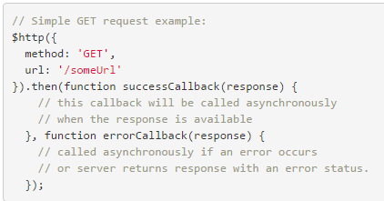
$http
The $http service is a core Angular service that facilitates communication with the remote HTTP servers via the browser's XMLHttpRequest object or via JSONP.
General usage
The $http service is a function which takes a single argument — a configuration object — that is used to generate an HTTP request and returns a promise.

Slide 20
The response object has these properties:
data – {string|Object} – The response body transformed with the transform functions.
status – {number} – HTTP status code of the response.
headers – {function([headerName])} – Header getter function.
config – {Object} – The configuration object that was used to generate the request.
statusText – {string} – HTTP status text of the response.
A response status code between 200 and 299 is considered a success status and will result in the success callback being called. Note that if the response is a redirect, XMLHttpRequest will transparently follow it, meaning that the error callback will not be called for such responses.

Slide 21

Shortcut methods
Shortcut methods are also available. All shortcut methods require passing in the URL, and request data must be passed in for POST/PUT requests. An optional config can be passed as the last argument.
Complete list of shortcut methods:
$http.get
$http.head
$http.post
$http.put
$http.delete
$http.jsonp
$http.patch

Slide 22

Setting HTTP Headers
The $http service will automatically add certain HTTP headers to all requests. These defaults can be fully configured by accessing the $httpProvider.defaults.headers
configuration object, which currently contains this default configuration:
$httpProvider.defaults.headers.common (headers that are common for all requests):
Accept: application/json, text/plain, * / *
$httpProvider.defaults.headers.post: (header defaults for POST requests)
Content-Type: application/json
$httpProvider.defaults.headers.put (header defaults for PUT requests)
Content-Type: application/json

Slide 23
Run Example at:-
http://www.w3schools.com/angular/angular_http.asp

Slide 24
Deprecation Notice:-
The $http legacy promise methods success and error have been deprecated. Use the standard then method instead.
Compare response types of .then and .success/.error

